Slide 1
Computer Architectures Session 1
Single cycle RISC-V processor
TAs :
Jun Yin (jun.yin@kuleuven.be)
Yuanyang Guo (yuanyang.guo@imec.be)
Linyan Mei (linyan.mei@kuleuven.be)
Yunzhu Chen (yunzhu.chen@imec.be)

Slide 2
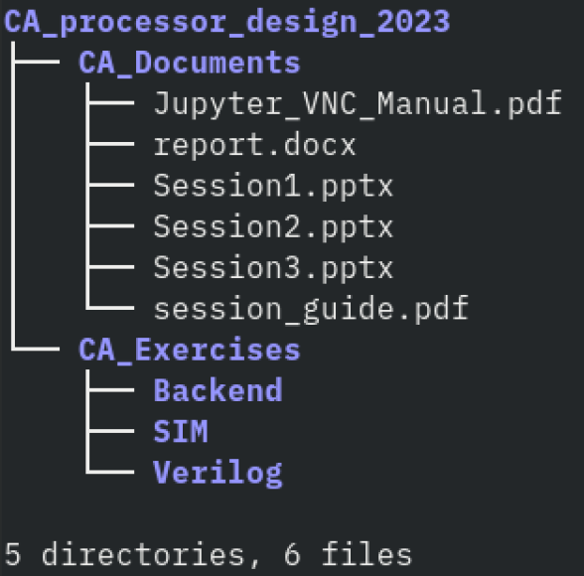
Course material
Extra resources
Computer organization and design. RISC-V edition.
https://owncloud.esat.kuleuven.be/index.php/s/HPc2rfQ5LaYfqZm
RISC-V specification
https://riscv.org/wp-content/uploads/2017/05/riscv-spec-v2.2.pdf
RISC-V green card
https://inst.eecs.berkeley.edu/~cs61c/fa17/img/riscvcard.pdf
Verilog tutorial
https://www.asic-world.com/verilog/veritut.html
RISC-V machine code generator *
https://github.com/Kritagya-Agarwal/Assembly-To-Machine-Code-RISC-V
Provided material
* assembles RV64 but only simulates RV32, only use it for assembly to machine code translation

Slide 3

Objective
Chapter 4
RTL design of a RISC-V microprocessor
Simple Implementation
Pipelined implementation
Data Hazard resolution
Advanced Acceleration
Branch prediction
SIMD
...
https://owncloud.esat.kuleuven.be/index.php/s/HPc2rfQ5LaYfqZm
Notes:
Objective is to implement a RISC-V processors based on Chapter 4 for the Pat& Hen.

Slide 4

Objective
Session 1
Session 2
Session 3
Single cycle processor skeleton
Functional single cycle processor
Single cycle processor with multiplication
Pipelined processor
Pipelined processor with data hazard resolution
Advanced acceleration
Simulation
Backend flow (synthesis-only)
Backend flow (complete)

Slide 5

Objective
Session 1
Session 2
Session 3
Single cycle processor skeleton
Functional single cycle processor
Single cycle processor with multiplication
Pipelined processor
Pipelined processor with data hazard resolution
Advanced acceleration
Simulation
Backend flow (synthesis-only)
Backend flow (complete)

Slide 6
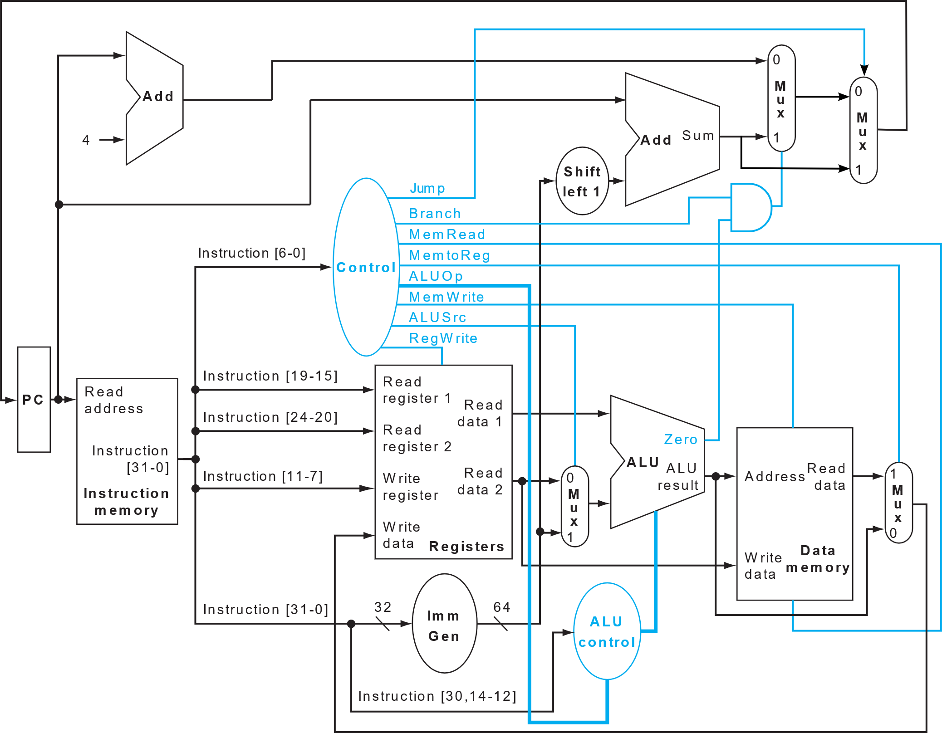
Base architecture
cpu.v
pc.v
RTL
alu_control.v
alu.v
branch_unit.v
control_unit.v
cpu.v
immediate_extend_unit.v
mux_2.v
pc.v
register_file.v
sram.v
control_unit.v
branch_unit.v
alu.v
register_file.v
immediate_extend_unit.v
alu_control.v
Patterson-Hennessy Section 4.1 to 4.4

Slide 7
Session Objectives
Single cycle processor skeleton
Functional single cycle processor
Functional single-cycle processor
Modify the control_unit.v to support BEQ, JUMP, LD, SD, ADDI and R-type ALU instructions (ALU_R)
Run SIMPLE_PROGRAM
Copy the instruction and data memory for simple program to imem and dmem
cat data/testcode_m/simpleprogram_imem_content.txt > data/imem_content.txt
cat data/testcode_m/simpleprogram_dmem_content.txt > data/dmem_content.txt
Run simulation with make nc
Run MULT1
See above with mult1 instead of simpleprogram
Simple Program
addi x8, x0, 7
addi x9, x8, 2
sd x9, 0(x0)
ld x17, 0(x0)
ld x18, 8(x0)
add x19, x17, x18
beq x9, x17, FINAL
add x20, x8, x9
FINAL: add x20, x18, x19
sll x21, x18, x8
STOP
STOP is a "fake" instruction used for the cpu_tb to recognize the end of the program (See line 304-306 of cpu_tb.v)

Slide 8
Session Objectives
Single cycle processor skeleton
Functional single cycle processor
Multiplication algorithm
# init
addi x16, x0, 80
addi x8, x0, 0
addi x9, x0, 0
addi x10, x0, 1
# Looping over operands
M1:ld x17, 0(x8)
ld x18, 8(x8)
addi x23, x0, 64
addi x19, x0, 1
addi x20, x0, 0
add x22, x0, x17
# Multiplication
LOOP_0: and x21, x18, x19
beq x21, x0, SHIFTING_0
add x20, x20, x22
SHIFTING_0: sll x22, x22, x10
sll x19, x19, x10
addi x23, x23, -1
beq x23, x0, M2
jal LOOP_0
# Summing results
M2: add x9, x9, x20
addi x16, x16, -16
addi x8, x8, 16
beq x16, x0, FINISH
jal M1
FINISH:
x16: Total size of data memory
x8: Data Memory Pointer
x23: Iteration over the number of bits
x20: Accumulated result of each multiplication
x9: Final result
Algorithm 1:
Acc = 0
N = operand1
Traverse each bit of operand2 (LSB -> MSB)
If the bit of operand2 is 1, accumulate. Acc = Acc + N.
If the bit is 0, Acc = Acc.
Left shift N by 1 position.
 |  |  | 1 | 1 | 0
 |  |  | 1 | 0 | 1
 |  |  | 1 | 1 | 0
 |  | 0 | 0 | 0
 | 1 | 1 | 0
 | 1 | 1 | 1 | 1 | 0
MULT1
Multiply adjacent operand in pairs (5 multiplications) using Algorithm 1
Sums results together

Slide 9
Session Objectives
Functional single cycle processor
Single cycle processor with multiplication
MULT2
Single cycle processor with multiplication support
Modify the control_unit.v, alu_control.v and alu.v to support the mul instruction
Run MULT2
# load operands
ld x8, 0(x0)
ld x9, 8(x0)
ld x10, 16(x0)
ld x11, 24(x0)
ld x12, 32(x0)
ld x13, 40(x0)
ld x14, 48(x0)
ld x15, 56(x0)
ld x16, 64(x0)
ld x17, 72(x0)
# multiplication
mul x18, x8, x9
mul x19, x10, x11
mul x20, x12, x13
mul x21, x14, x15
mul x22, x16, x17
#sums
addi x23, x0, 0
nop
nop
nop
add x23, x23, x18
nop
nop
nop
add x23, x23, x19
nop
nop
nop
add x23, x23, x20
nop
nop
nop
add x23, x23, x21
nop
nop
nop
add x23, x23, x22
nop
nop
nop
nop

Slide 10
Project structure
Verilog
RTL
RTL sources
sky130_sram_2rw.v
Memory behaviour model
cpu_tb.v
testbench
Backend
CA_RISCV.ipynb
Python file to run backend flow
Figs
OpenRAM_output
Setup.sh
SIM
Simulation related resources
data
Instruction and data memory sources
testcode_m
Imem and dmem contents used for different exercises
dmem_content.txt
Data memory content
Imem_content.txt
Instruction memory content
files_verilog.f
Makefile
Makefile with simulation related commands
Incisiv_15.20.058.rc
nc_sim requirements

Slide 11
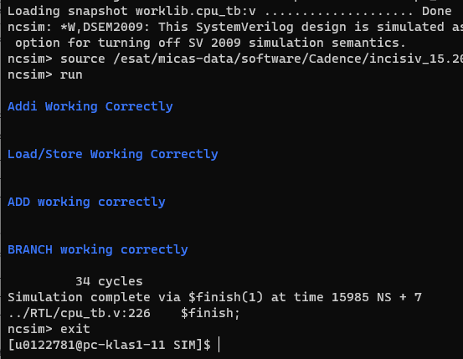
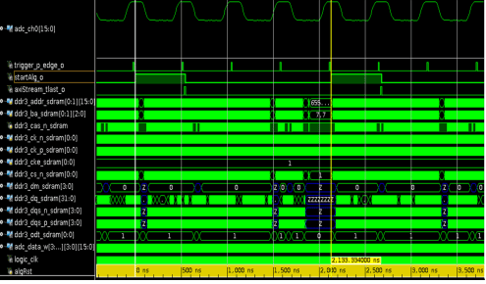
Simulation Tool
HDL files (RTL/*)
Testbench (RTL/cpu_tb.v)
Simulation (NC-Verilog)
Tool to simulate the behaviour of the RTL
In the ./SIM folder
source incisiv_15.20.058.rc
Make simulation
make nc
uses cpu_tb.v, and the content of SIM/data/imem_content and SIM/data/dmem_content to verify that the current RTL is able to run the considered program.
make nc_gui
same but provides traces for debugging (see next slide)
NC-Verilog
make nc
make nc_gui
Test if program runs properly
Provide traces for debugging

Slide 12
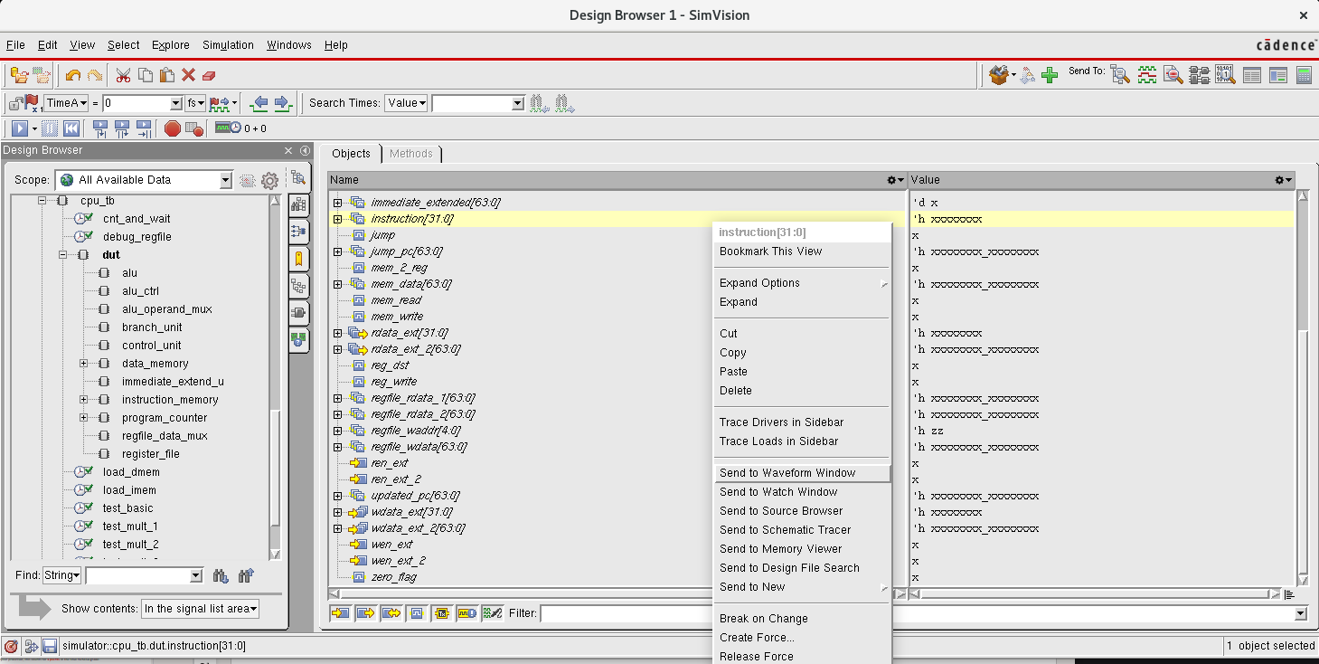
Right click
Design under test (select it)​

Slide 13
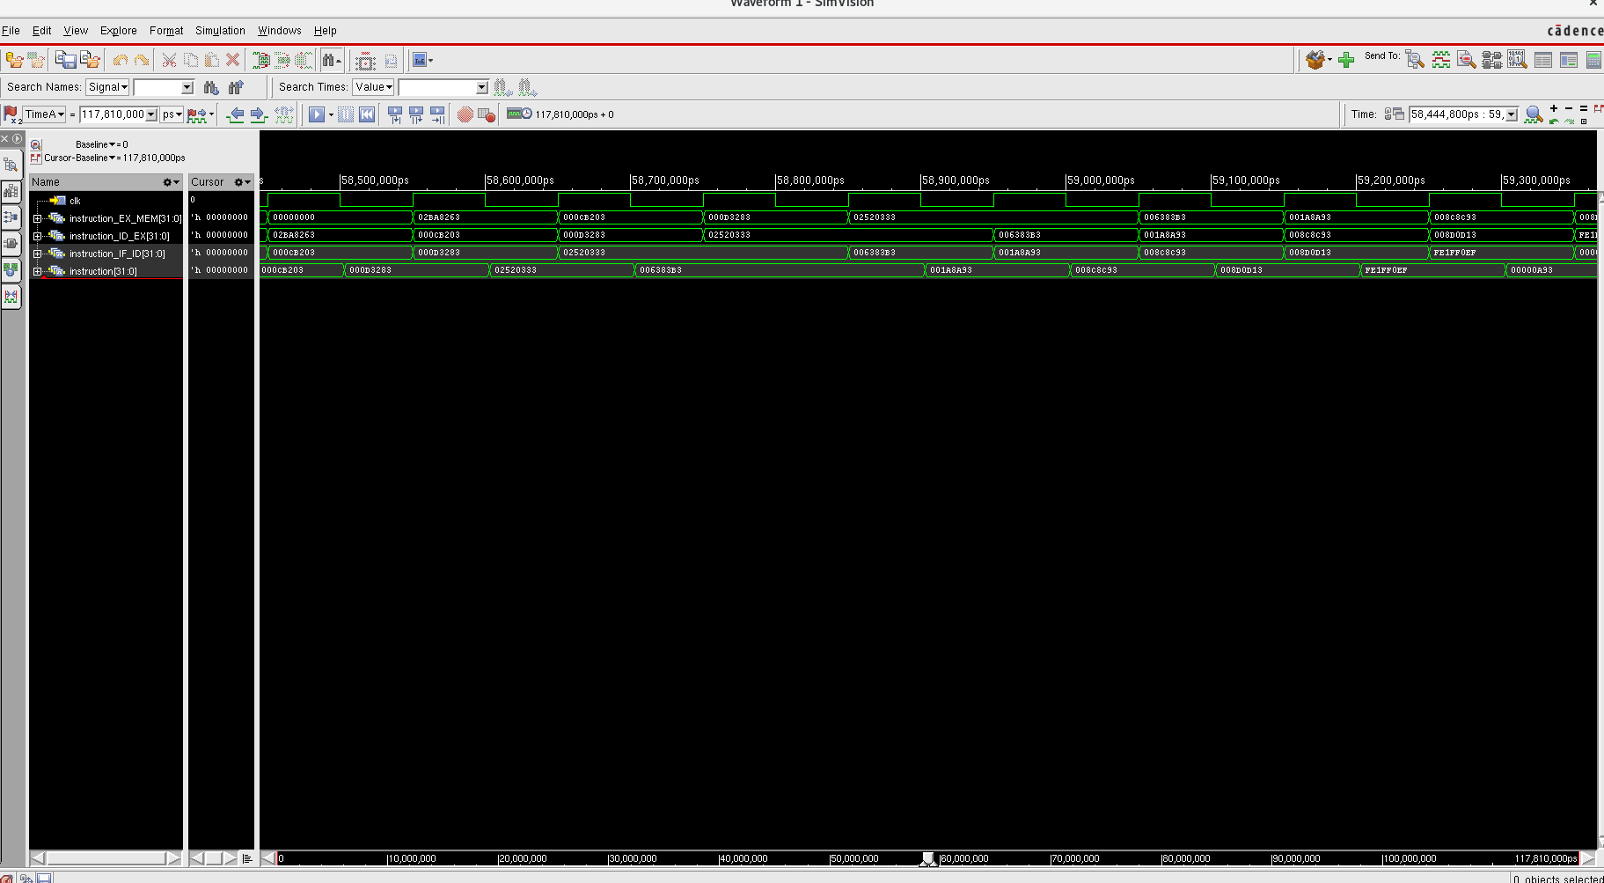
Click Run All
to see the waveform

Slide 14
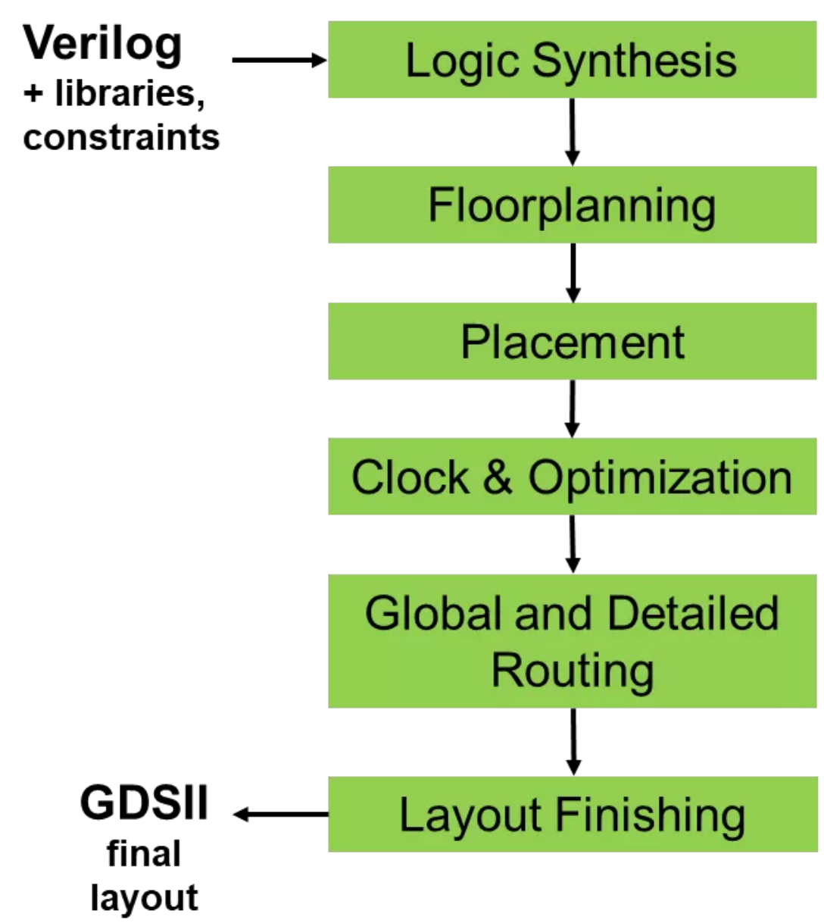
Digital Backend Flow
The RTL design is synthesized into a gate-level netlist.
Decide on the chip area and set memory macros location in the chip.
The synthesized gates are placed in the chip according to the floorplan.
A clock tree is generated to distribute the clock signal throughout the chip, while minimizing skew and ensuring timing requirements are met.
The global routing involves determining the overall routing paths between the blocks and macros; The detailed routing creates the actual metal interconnects between the gates.
Design rule checking: Once the routing is complete, the design is checked against a set of design rules to ensure that it is manufacturable.

Slide 15
Backend Flow in this exercise
Three key components:
OpenLane
SKY130
OpenRAM

Slide 16
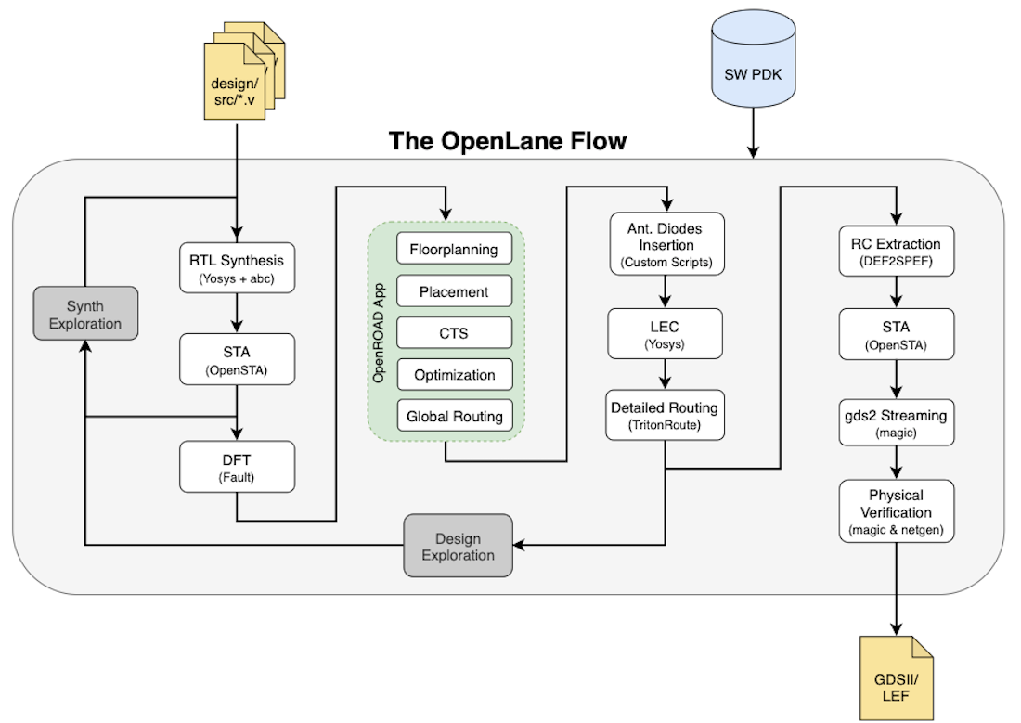
Automated Backend Flow: OpenLane
OpenLane is an automated RTL to GDSII flow based on several components.
More details on: https://openlane.readthedocs.io/en/latest/flow_overview.html

Slide 17

Open-source PDK: SKY130
PDK: Process Design Kit - information about the process technology
PDK includes
Process documentation
Device models
Layout design rules
Design libraries: Pre-designed circuit blocks, such as standard cells, memories, and IO cells
…
More details on: https://skywater-pdk.readthedocs.io/en/main/index.html

Slide 18

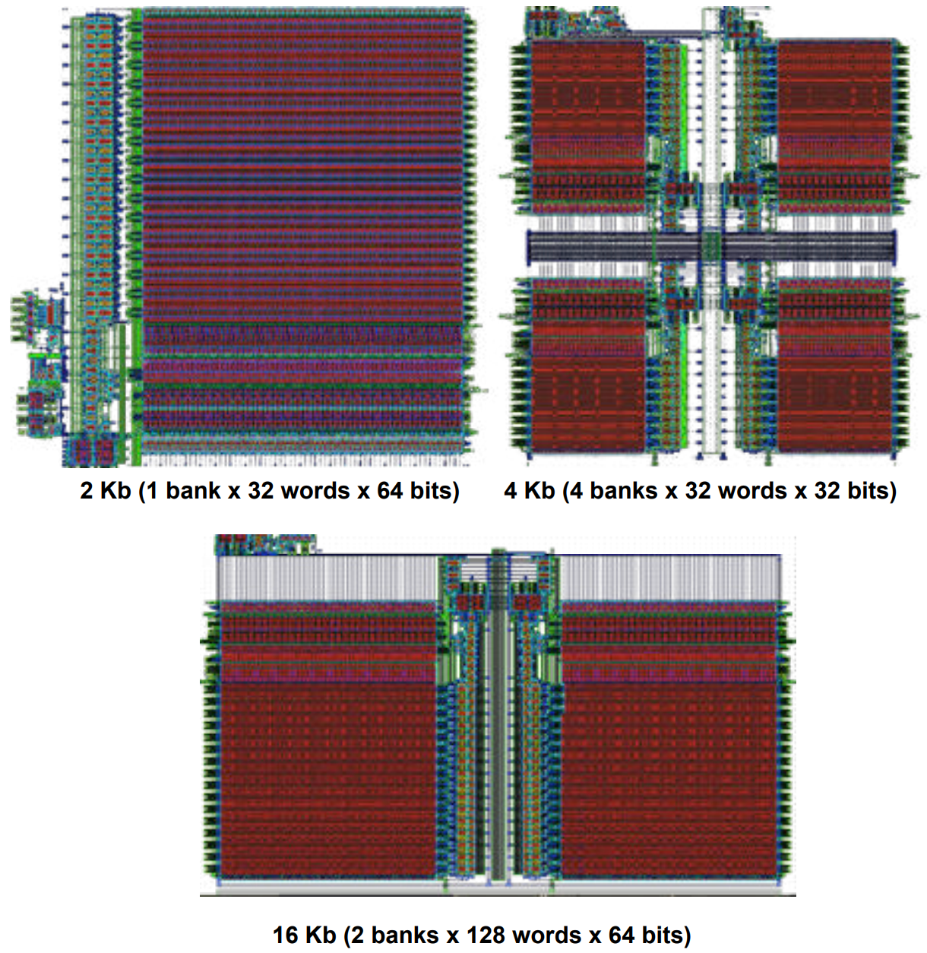
Open-source SRAM Compiler: OpenRAM
Create SRAM for ASIC design:
Layout
Netlists
Timing and power models
Placement and routing models
In the exercise, the memory macros used by instruction memory and data memory are already generated for you.
More details on: https://openram.org/

Slide 19
Environment settings + Backend tools installation
Backend tools installation:
Enter the folder: Backend/
In the folder, run the command: source setup.sh. This should start installing the backend tools and jupyter by micromamba. (This step takes about 5 min)
In the terminal, type the command jupyter-lab. This should introduce you to the website of jupyer notebook.
PS1: every time you want to use the backend tools and jupyter, please run the command source setup.sh.
PS2: if you want to use jupyter-lab at home, see manual how to open jupyter notebook remotely document. (CA_Documents/Jupyter_VNC_Manual.pdf)

Slide 20
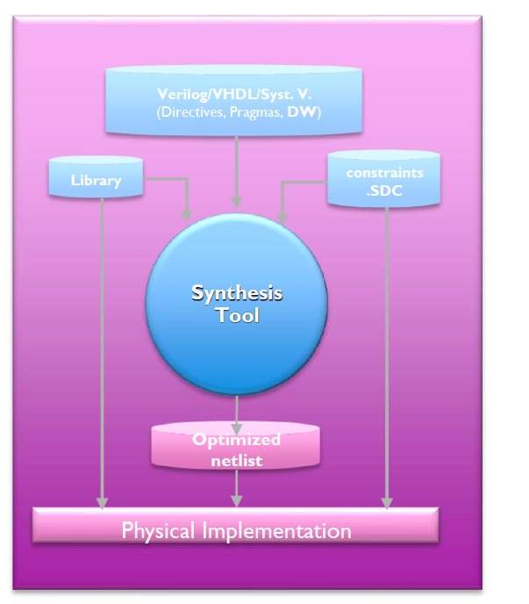
Synthesis: a critical step in the backend flow
Session 1 will only use synthesis in the backend flow

Slide 21
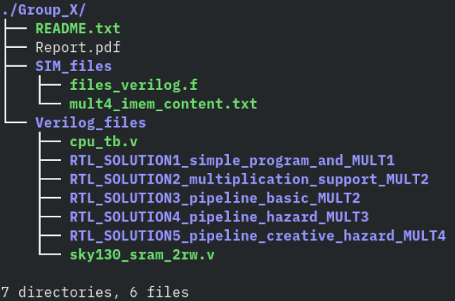
REMARKS
The assignments must be completed in groups of 2 people.
After completing each one of the exercises the results must be shown to the TAs for its correspondent evaluation.
You will hand in a small report which includes the performance of your processor after each step and some questions to answer.
This project counts for 4 points in the final H05d3A grade. The report and your final processor design need to be handed in through Toledo, following the below file structure:
Name your project as Group_X (X is your group number);
Put all the students’ name and students’ R-number of the group in README.txt;
You can also put anything that you think we need to know before running your project in the README.txt.
The deadline of the project is May. 19th, 2023.

Slide 22

Keep your project safe!
We highly suggest you to use git as a versioning tool.
It helps you to:
keep track of modifications
automatically sync the project between group members
allow TAs to support you more easily
Please have a look at the dedicated guide.
Please keep all 5 versions of your processor (RTL), we will grade based on them!

